Slide 1
Area
Classwork
12/05/2022
Need whiteboards
Aim:
Calculate the area of a parallelogram and kite.
Convert squared units of measurement.
Starter Work out the area of the following shapes to 1 decimal place.
13.5 m²
3cm
4 cm
9 m
5cm
50.3 cm²
41 cm²
4cm
8cm
3 m

Slide 2
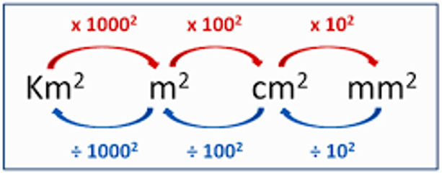
Area (I do)
Convert 16cm² to mm²
95mm² to cm²
7m² to cm²
8400cm² to m²

Slide 3

Whiteboards
Convert the following:
${5m}^{2} = {cm}^{2}$
${9cm}^{2}= {mm}^{2}$
$100 000{mm}^{2}= {cm}^{2}$

Slide 4
Your turn…
Work through the sheet at your own pace.

Slide 5
Area of a parallelogram
Area of a parallelogram = base x perpendicular height
(A = bh)
h
h
b
b

Slide 6
Find the area of this parallelogram
A = b x h
= 15.6 x 18.1
= 282.36 m²
18.1 m
15.6 m

Slide 7
Find the area of this parallelogram
A = b x h
= 22.4 x 12.9
= 288.96mm²
22.4mm
12.9mm

Slide 8
Area of a kite
Area of a kite = ½ width x height
(A= ½wh)
w
w
h
h
½w

Slide 9
Whiteboards

Slide 10
Find the area of this kite
A = ½wh
= ½ x 23.4 x 18.6
= 217.62 mm²
18.6 mm
23.4 mm

Slide 11
Find the area of this kite
A = ½wh
= ½ x 19.5 x 22.4
= 436.8m²
19.5m
22.4m

Slide 12
Individual tasks
Complete “converting Units of Area” task sheet
Finish yesterday’s composite area questions.

